Slide 1


Microcontrollers and Embedded Systems
Unit II: Internal Peripherals
Symbiosis Institute of Technology, Nagpur
Symbiosis Institute of Technology, Nagpur Campus (SIT-N)

Slide 2

Internal Peripherals
Study of SFRs and Block diagram of the following peripherals: I/O Ports, Interrupts, Timers/Counters, UART. Assembly programming with 8051: I/O Programming, Timers/counters, Serial Communication, Interrupts.

Slide 3
8051 Timer/Counter
Many microcontroller applications require the counting of external events, such as the frequency of a pulse train, or the generation of time delays . These task can be accomplished using software techniques
But the software loops for counting or timing keep the processor occupied so that other functions are not done
To relieve the processor of this burden, two 16-bit up counters/timers (T0 and T1) are provided in 8051 .
Each timer can also act as seperate 8 bit registers.

Slide 4
8051 Timer/Counter
Each counter may be programmed to count internal clock pulse (or to generate time delay), acting as a timer, or programmed to count external pulses as a counter.
The counters are divided into two 8-bit registers called the timer low(TL0 for timer 0 and TL1 for timer 1) and high (TH0 for timer 0 and TH1 for timer 1) bytes.
Counters always count up.
All counter action is controlled by bit states in the timer mode control register (TMOD), and timer/counter control register (TCON), and certain instructions

Slide 5
8051 Timer/Counter
When the program wants to count a certain number of internal pulses or external events, a number is placed in one of the counters.
The counter increments from the initial number to the maximum and then rolls over to zero on the final pulse and set the timer flag.
The flag condition may be tested by an instruction to tell that the count has been accomplished, or the flag may be used to interrupt the program

Slide 6
8051 Timer/Counter
Timer
If the counter is programed to be a timer, it will count the internal clock frequency of the 8051-oscillator divided by 12.
Ex: If the crystal frequency is 6 MHz, then the timer clock will have a frequency of 500 KHz.
The oscillator clock pulse will reach the timer, if the C/T bit in the TMOD must be ‘0’, TR_{X} in the TCON must be 1(timer run) and the gate bit in the TMOD must be ‘0’ or external pin INT_{X} must be ‘1’

Slide 7


8051 Timer/Counter
OSC
÷12
TLx
(8 Bit)
THx
(8 Bit)
TFx
(1 Bit)
INTERRUPT

Slide 8
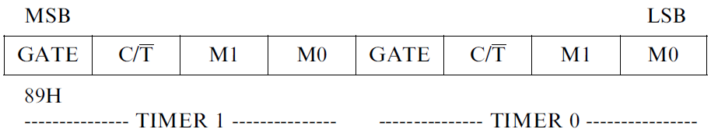
The Timer Mode Control (TMOD) Register
8051 Timer/Counter
GATE:
The bit which controls RUN/STOP of timer 0 /timer 1
When set, timer/counter x is enabled, if INTx pin is high and TRx is set.
When cleared, timer/counter x is enabled, if TRx bit set.
C/T*:
When set, counter operation (input from Tx input pin).
When cleared, timer operation (input from internal clock).

Slide 9
The Timer Mode Control (TMOD) Register
8051 Timer/Counter
The TMOD byte is not bit addressable.
M1 , M0:
The timer/counter operating mode select bit. Set/Cleared by program to select mode
M1 | M0 | Mode
0 | 0 | 0
0 | 1 | 1
1 | 0 | 2
1 | 1 | 3

Slide 10
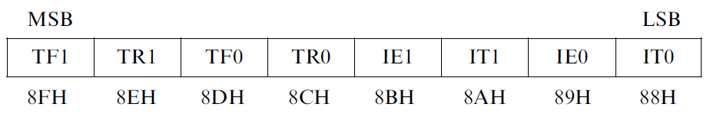
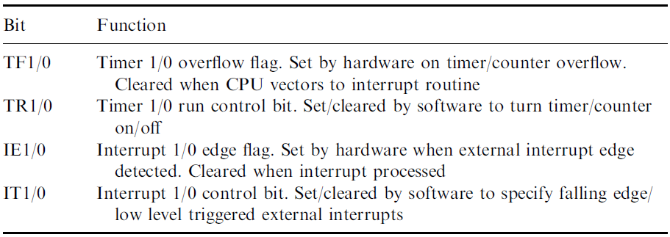
The Timer Control (TCON) Register
8051 Timer/Counter
The TCON byte is bit addressable.

Slide 11
8051 Timer/Counter
8051 TIMERS
Timer 0
Timer 1
Mode 0
Mode 0
Mode 1
Mode 1
Mode 2
Mode 2
Mode 3

Slide 12
8051 Timer/Counter
Timer 0
OSC
÷12
TL0
TH0
TF0
INTERRUPT
The oscillator clock pulse will reach the timer, if the C/T bit in the TMOD must be ‘0’, TR0 in the TCON must be 1(timer run) and the gate bit in the TMOD must be ‘0’ or external pin INT0 must be ‘1

Slide 13
8051 Timer/Counter
Timer 0 – Mode 0
13 Bit Timer / Counter
OSC
÷12
TL0
(5 Bit)
TH0
(8 Bit)
TF0
INTERRUPT
M1 | M0 | Mode
0 | 0 | 0
The Mode 0 operation is the 8-bit timer or counter with a 5-bit pre-scaler.
So, it is a 13-bit timer/counter.
It uses 5 bits of TL0 and all the 8-bits of TH0
Maximum Count = 1FFFh (0001111111111111)

Slide 14
8051 Timer/Counter
Timer 0 – Mode 0
The pulse input is divided by 32 in TL0
So, the TH count the original oscillator frequency reduced by 384 (12 x 32)
If the crystal frequency is 6MHz, the final frequency to TH0 is 15625 Hz.
Every 32 event for counter operations or 32 machine cycles for timer operation, the TH0 register will be incremented by 1.
When the TH0 overflows from FFH to 00H, then the TF0 of TCON register will be high (set), and it stops the timer/counter.
Maximum Count = 1FFFh (0001111111111111)

Slide 15
8051 Timer/Counter
Timer 0 – Mode 0
Example:1
If TH0 is holding F0H, and it is in timer mode, then TF0 will be high after 10H * 32 = 512 machine cycles. *10h = 16
MOV TMOD, #00H
MOV TH0,#0F0H
MOV IE, #82H
SETB TR0

Slide 16
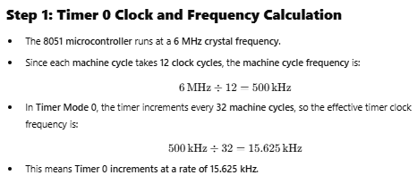
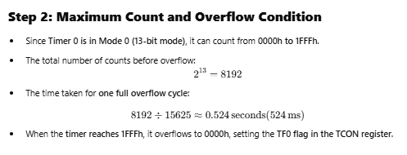
8051 Timer 0 in Mode 0 (13-bit Timer Mode)
In Timer Mode 0, Timer 0 functions as a 13-bit counter, meaning it can count from 0000h to 1FFFh (0 to 8191 in decimal) before overflowing. The timer operates by incrementing every 32 machine cycles.

Slide 17
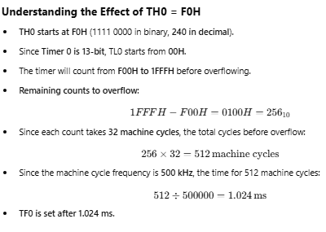
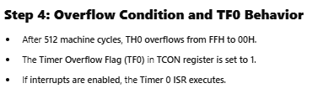

Slide 18
8051 Timer/Counter
Timer 0 – Mode 1
16 Bit Timer / Counter
OSC
÷12
TL0
(8 Bit)
TH0
(8 Bit)
TF0
M1 | M0 | Mode
0 | 1 | 1
INTERRUPT
The Mode 1 operation is the 16-bit timer or counter.
Every event for counter operations or machine cycles for timer operation, the TH0– TL0 register-pair will be incremented by 1.
When the register pair overflows from FFFFH to 0000H, then the TF0 of TCON register will be high (set), and it stops the timer/counter.

Slide 19
8051 Timer/Counter
Timer 0 – Mode 1
Example:1
If the TH0 – TL0 register pair is holding FFF0H, and it is in timer mode, then TF0 will be high after 10H = 16 machine cycles.
If the clock frequency is 12MHz, then the following instructions generate an interrupt 16 µs after Timer0 starts running.
MOV TMOD, #01H
MOV TL0, #0F0H
MOV TH0, #0FFH
MOV IE, #82H
SETB TR0
Example:2
If TH0 – TL0 start at 0000H, then TF0 will be high (set) after 0.1311 seconds (if Crystal frequency is 6MHz)
Maximum Count = FFFFh (1111111111111111)

Slide 20
8051 Timer 0 in Mode 1 (16-bit Timer Mode)
In Timer Mode 1, Timer 0 operates as a full 16-bit timer, meaning it counts from 0000h to FFFFh (0 to 65535 in decimal) before overflowing. Let's analyze the scenario where TH0 – TL0 holds FFF0H and determine when TF0 (Timer Overflow Flag) is set.

Slide 21
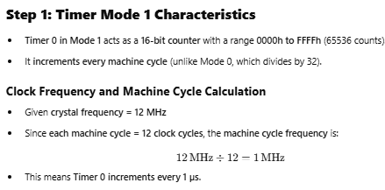

Slide 22
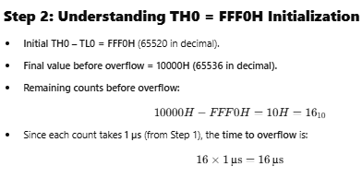

Slide 23
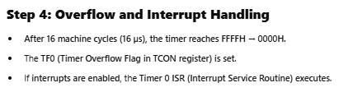
MOV TMOD, #01H ; Timer 0, Mode 1 (16-bit timer mode)
MOV TH0, #0FFH ; Load TH0 with FFH
MOV TL0, #0F0H ; Load TL0 with F0H
MOV IE, #82H ; Enable Timer 0 Interrupt (EA = 1, ET0 = 1)
SETB TR0 ; Start Timer 0

Slide 24
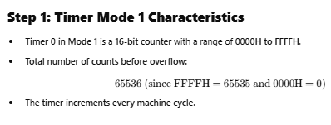
8051 Timer 0 in Mode 1 (16-bit Timer Mode) – Example 2
In this example, Timer 0 starts at 0000H and runs until it overflows at FFFFH. We will calculate how long it takes for TF0 (Timer Overflow Flag) to be set, given that the crystal frequency is 6 MHz.

Slide 25
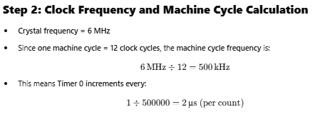
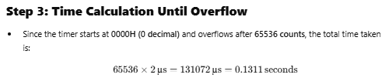

Slide 26
MOV TMOD, #01H ; Timer 0, Mode 1 (16-bit mode)
MOV TH0, #00H ; Load TH0 with 00H
MOV TL0, #00H ; Load TL0 with 00H
MOV IE, #82H ; Enable Timer 0 Interrupt (EA = 1, ET0 = 1)
SETB TR0 ; Start Timer 0
If interrupts are enabled, the Timer 0 ISR will execute.
Timer 0 starts at 0000H.
TF0 will be set after 0.1311 seconds (131.1 ms).

Slide 27
8051 Timer/Counter
Timer 0 – Mode 2
8 Bit Timer / Counter with Auto-reload
OSC
÷12
TL0
(8 Bit)
TH0
(8 Bit)
TF0
M1 | M0 | Mode
1 | 0 | 2
INTERRUPT
Reload
This mode use only the TL0 as an 8-bit counter
TH0 is used to hold the value that is loaded into TL0 every time TL0 overflow from FFh to 00h
The timer flag TF0 set when TL0 overflows
TH0
(8 Bit)

Slide 28
8051 Timer/Counter
Timer 0 – Mode 2
In mode 2, every event for counter operations or machine cycles for timer operation, the TL0 register will be incremented by 1.
When the register pair overflows from FFH to 00H, then the TF0 of TCON register will be high (set), also theTL0 will be reloaded with the content of TH0 and starts the operation again.
This feature is known as auto - reload
Maximum Count = FFh (11111111)

Slide 29
8051 Timer/Counter
Timer 0 – Mode 2
Example:1
if the TH0 and TL0 register both are holding F0H and it is in timer mode, then TF0 will be high after 10H= 16 machine cycles.
If the clock frequency is 12MHz this happens after 16 µs, then the following instructions generate an interrupt once every 16 µs after Timer0 starts running.
Example:2
Placing 9Ch in TH0 will result in a delay of 0.0002 seconds before the overflow flag is set if 6MHz crystal is used
MOV TMOD, #02H
MOV TL0, #0F0H
MOV TH0, #0F0H
MOV IE, #82H
SETB TR0

Slide 30
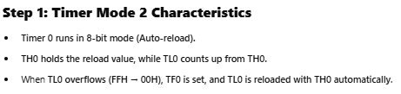
8051 Timer 0 in Mode 2 (8-bit Auto-Reload Mode) – Example 1
In Timer Mode 2, Timer 0 operates as an 8-bit auto-reload timer, meaning that TH0 holds the reload value, and TL0 is incremented until it overflows. When TL0 overflows (reaches FFH → 00H), TF0 is set, and TL0 is automatically reloaded with TH0.

Slide 31
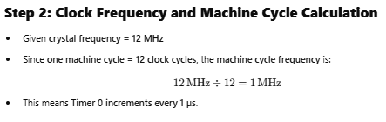
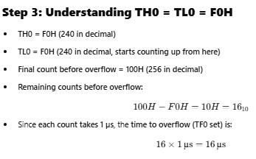

Slide 32
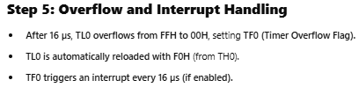
MOV TMOD, #02H ; Timer 0, Mode 2 (8-bit auto-reload mode)
MOV TH0, #0F0H ; Load TH0 with F0H (reload value)
MOV TL0, #0F0H ; Load TL0 with F0H (initial count)
MOV IE, #82H ; Enable Timer 0 Interrupt (EA = 1, ET0 = 1)
SETB TR0 ; Start Timer 0

Slide 33
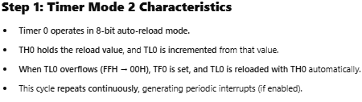
8051 Timer 0 in Mode 2 (8-bit Auto-Reload Mode) – Example 2
In Timer Mode 2 (8-bit Auto-Reload Mode), TH0 holds the reload value, and TL0 is incremented until it overflows. Once TL0 overflows from FFH to 00H, the TF0 flag is set, and TL0 is automatically reloaded with TH0.

Slide 34
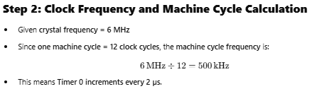
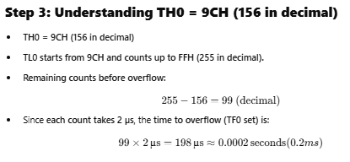

Slide 35
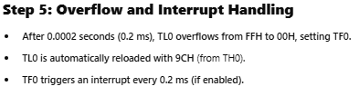
MOV TMOD, #02H ; Timer 0, Mode 2 (8-bit auto-reload mode)
MOV TH0, #09CH ; Load TH0 with 9CH (reload value)
MOV TL0, #09CH ; Load TL0 with 9CH (initial count)
MOV IE, #82H ; Enable Timer 0 Interrupt (EA = 1, ET0 = 1)
SETB TR0 ; Start Timer 0

Slide 36
8051 Timer/Counter
OSC
÷12
TL0
(8 Bit)
TF0
Timer 0 – Mode 3
INTERRUPT
M1 | M0 | Mode
1 | 1 | 3
OSC
÷12
TH0
(8 Bit)
TF1
INTERRUPT
Mode 3 is different for Timer0 and Timer1. When the Timer0 is working in mode 3, the TL0 will be used as an 8-bit timer/counter. It will be controlled by the standard Timer0 control bits, T0 and INT0 inputs

Slide 37
8051 Timer/Counter
Timer 0 – Mode 3
When the TL0 overflows from FFH to 00H, then the TF0 of TCON register will be high (set)
The TH0 is used as an 8-bit timer but not the counter.
This is controlled by Timer1 Control bit TR1.
When the TH0 overflows from FFH to 00H, then TF1 is set to 1.
When the Timer1 is working in Mode 3, it simply holds the count but does not run.
When Timer0 is in mode 3, the Timer1 is configured in one of the mode 0, 1 and 2.
.

Slide 38
8051 Timer/Counter
Timer 0 – Mode 3
In this case, the Timer1 cannot interrupt the microcontroller. When the TF1 is used by TH0 timer, the Timer1 is used as Baud Rate Generator.
If the Timer0 is in mode3, and Timer1 is working on either 0, 1 or 2, then the run control (TR1) of the Timer1 is activated when the gate bit is low or INT1 is high.
The run control is deactivated when the gate is high and INT1 is low.

Slide 39
8051 Timer/Counter
Timer 1
OSC
÷12
TL1
TH1
TF1
INTERRUPT
The oscillator clock pulse will reach the timer, if the C/T bit in the TMOD must be ‘0’, TR1 in the TCON must be 1(timer run) and the gate bit in the TMOD must be ‘0’ or external pin INT1 must be ‘1

Slide 40
8051 Timer/Counter
Timer 1 – Mode 0
13 Bit Timer / Counter
OSC
÷12
TL1
(5 Bit)
TH1
(8 Bit)
TF1
INTERRUPT
M1 | M0 | Mode
0 | 0 | 0
Maximum Count = 1FFFh (0001111111111111)

Slide 41
8051 Timer/Counter
Timer 1 – Mode 1
16 Bit Timer / Counter
OSC
÷12
TL1
(8 Bit)
TH1
(8 Bit)
TF1
INTERRUPT
M1 | M0 | Mode
0 | 1 | 1
Maximum Count = FFFFh (1111111111111111)

Slide 42
8051 Timer/Counter
Timer 1 – Mode 2
8 Bit Timer / Counter with AUTORELOAD
OSC
÷12
TL1
(8 Bit)
TH1
(8 Bit)
TF1
INTERRUPT
M1 | M0 | Mode
1 | 0 | 2
Reload
TH1
(8 Bit)
Maximum Count = FFh (11111111)

Slide 43
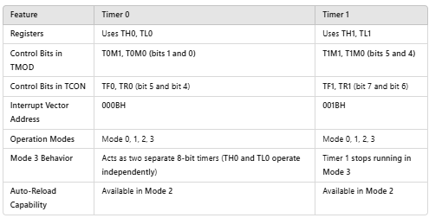

Slide 44
Programming Timers
8051 Timer/Counter
Example: Indicate which mode and which timer are selected for each of the following.
(a) MOV TMOD, #01H (b) MOV TMOD, #20H (c) MOV TMOD, #12H
Solution: We convert the value from hex to binary.
(a) TMOD = 00000001, mode 1 of timer 0 is selected.
(b) TMOD = 00100000, mode 2 of timer 1 is selected.
(c) TMOD = 00010010, mode 2 of timer 0, and mode 1 of timer 1 are selected.

Slide 45
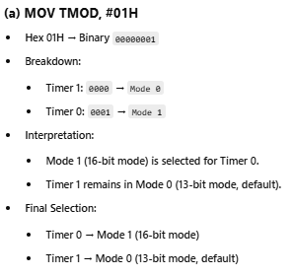

Slide 46
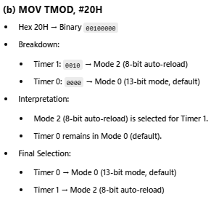

Slide 47
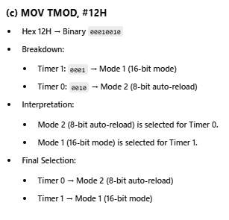

Slide 48
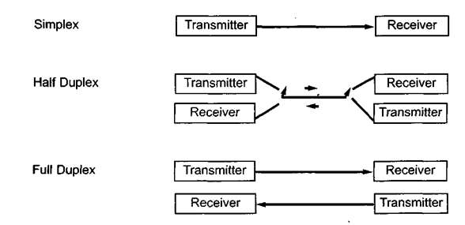
8051 Serial Communication
Basics of Serial Communication
In data transmission if the data can be transmitted and received, it is a duplex transmission.
simplex transmissions such as with printers, in which the computer only sends data.
Duplex transmissions can be half or full duplex, depending on whether or not the data transfer can be simultaneous.
If data is transmitted one way at a time, it is referred to as half duplex.
If the data can go both ways at the same time, it is full duplex.

Slide 49
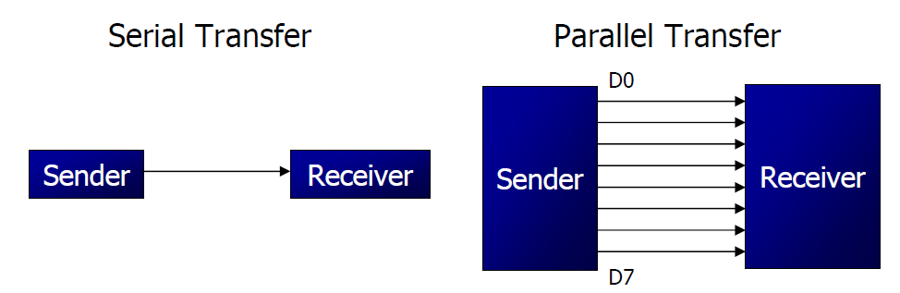
8051 Serial Communication
Basics of Serial Communication
Computers transfer data in two ways:
Parallel: Often 8 or more lines (wire conductors) are used to transfer data to a device that is only a few feet away.
Serial: To transfer to a device located many meters away, the serial method is used. The data is sent one bit at a time.

Slide 50
8051 Serial Communication
Basics of Serial Communication
Serial data communication uses two methods
Synchronous method transfers a block of data at a time
Asynchronous method transfers a single byte at a time
There are special IC’s made by many manufacturers for serial communications.
UART (universal asynchronous Receiver transmitter)
USART (universal synchronous-asynchronous Receiver-transmitter)

Slide 51
8051 Serial Communication
Basics of Serial Communication - Asynchronous
Asynchronous serial data communication is widely used for character-oriented transmissions
Each character is placed in between start and stop bits, this is called framing.
Block-oriented data transfers use the synchronous method.
The start bit is always one bit, but the stop bit can be one or two bits
The start bit is always a 0 (low) and the stop bit(s) is 1 (high)

Slide 52
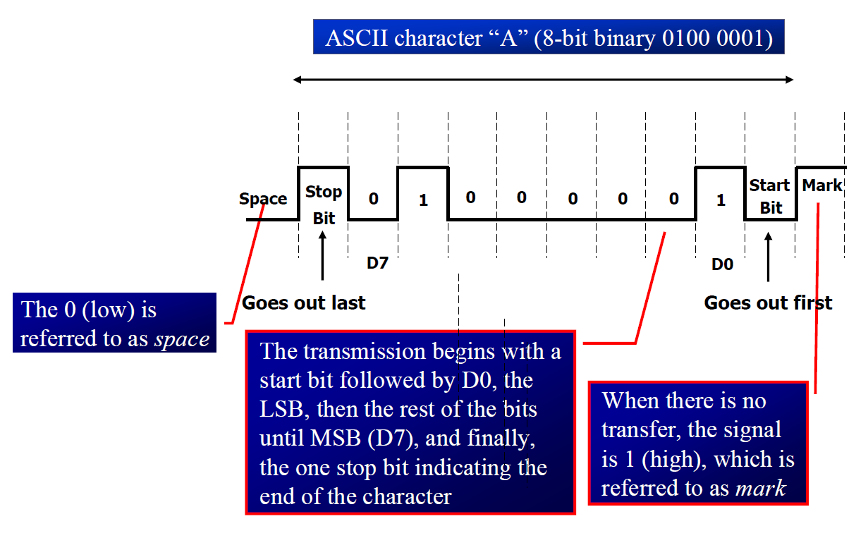
8051 Serial Communication

Slide 53

8051 Serial Communication
Synchronous Transmission:
In Synchronous Transmission, data is sent in form of blocks or frames.
This transmission is the full-duplex type. Between sender and receiver, synchronization is compulsory.
In Synchronous transmission, There is no gap present between data.
It is more efficient and more reliable than asynchronous transmission to transfer a large amount of data.

Slide 54
8051 Serial Communication
Data Transfer Rate
The rate of data transfer in serial data communication is stated in bps (bits per second).
Another widely used terminology for bps is baud rate.
It is modem terminology and is defined as the number of signal changes per second
Baud rate is the rate at which the number of signal elements or changes to the signal occurs per second when it passes through a transmission medium.

Slide 55
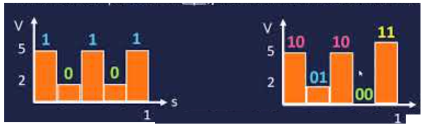
8051 Serial Communication
Data Transfer Rate
The higher a baud rate is the faster the data is sent/received.
In modems, there are occasions when a single change of signal transfers several bits of data

Slide 56
8051 Serial Communication
8051 Serial Port
Synchronous and Asynchronous
SCON Register is used to Control
Data Transfer through TXd & RXd pins
Some time - Clock through TXd Pin
Four Modes of Operation:
Mode 0 :Synchronous Serial Communication
Mode 1 :8-Bit UART with Timer Data Rate
Mode 2 :9-Bit UART with Set Data Rate
Mode 3 :9-Bit UART with Timer Data Rate

Slide 57
Registers related to Serial Communication
8051 Serial Communication
SBUF Register
SCON Register
PCON Register

Slide 58
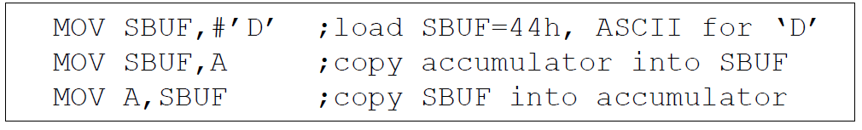
SBUF Register
8051 Serial Communication
SBUF is an 8-bit register used for serial Commn.
For a byte data to be transferred via the TxD line, it must be placed in the SBUF register.
The moment a byte is written into SBUF, it is framed with the start and stop bits and transferred serially via the TxD line.
SBUF holds the byte of data when it is received by 8051 RxD line.
When the bits are received serially via RxD, the 8051 de-frames it by eliminating the stop and start bits, making a byte out of the data received, and then placing it in SBUF.

Slide 59
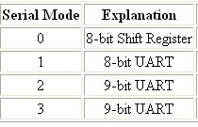
8051 Serial Communication
SCON Register
SM0 SM1 SM2 REN TB8 RB8 TI RI
Set when a
Character received
Set to Enable
Serial Data
reception
Set when Stop bit Txed
Enable Multiprocessor
Communication Mode(make it 0)
9th Data Bit
Sent in Mode 2,3(not widely
used)
9th Data Bit
Received in Mode 2,3
(not widely
used)

Slide 60
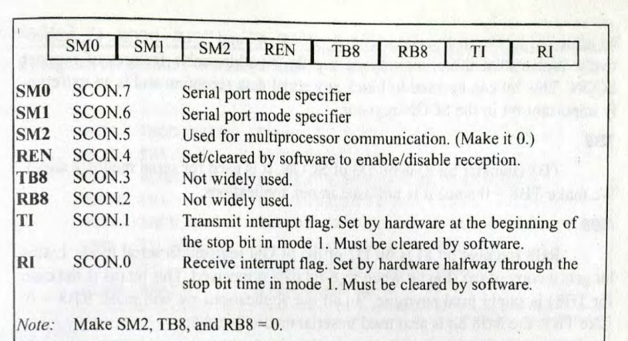

Slide 61

Serial Port – Mode 0
8051 Serial Communication
The Serial Port in Mode-0 has the following features:
Serial data enters and exits through RXD
TXD outputs the clock
8 bits are transmitted / received
The baud rate is fixed at (1/12) of the oscillator frequency

Slide 62
Serial Port – Mode 1
8051 Serial Communication
The Serial Port in Mode-1 has the following features:
Serial data enters through RXD
Serial data exits through TXD
On receive, the stop bit goes into RB8 in SCON
10 bits are transmitted / received
Start bit (0)
Data bits (8)
Stop Bit (1)
Baud rate is determined by the Timer 1 overflow rate.

Slide 63

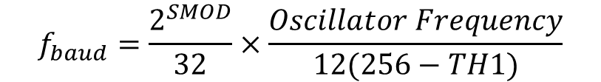
Serial Port – Mode 1
8051 Serial Communication
Baud rate is determined by the Timer 1 overflow rate.
Timer 1 is used in timer mode2 (8-bit auto reload) to generate the baud frequency
$$f_{baud}=\frac{2^{SMOD}}{32}×\frac{Oscillator Frequency}{12(256−TH1)}$$
SMOD is the control bit in PCON and can be 0 or 1
If Timer 1 not in mode2, then the baud rate is
$$f_{baud}=\frac{2^{SMOD}}{32}×Timer 1 overflow frequency$$

Slide 64
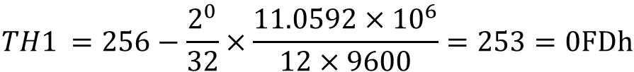
Serial Port – Mode 1
8051 Serial Communication
If standard baud rates are desired, then 11.0592 MHz crystal could be selected.
To get a standard rate of 9600 hertz , the setting of TH1 can be found as (if SMOD =0)
$$TH1 =256−\frac{2^{0}}{32}×\frac{11.0592×{10}^{6}}{12×9600}=253=0FDh$$

Slide 65
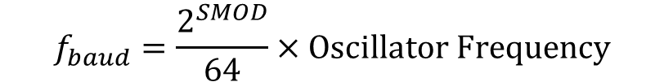
Serial Port – Mode 2
8051 Serial Communication
The Serial Port in Mode-2 has the following features:
Serial data enters through RXD
Serial data exits through TXD
9th data bit (TB8) can be assign value 0 or 1
On receive, the 9th data bit goes into RB8 in SCON
11 bits are transmitted / received
Start bit (0)
Data bits (9)
Stop Bit (1)
Baud rate is programmable
$$f_{baud}=\frac{2^{SMOD}}{64}×Oscillator Frequency$$

Slide 66
Serial Port – Mode 3
8051 Serial Communication
The Serial Port in Mode-3 has the following features:
Serial data enters through RXD
Serial data exits through TXD
9th data bit (TB8) can be assign value 0 or 1
On receive, the 9th data bit goes into RB8 in SCON
11 bits are transmitted / received
Start bit (0)
Data bits (9)
Stop Bit (1)
This mode is completely similar to mode 2, in mode 2 for triggering timer is used Whereas in this mode internal clock is used for triggering. It has a fixed baud rate.

Slide 67
8051 Serial Communication
Programming Serial Data Transmission
TMOD register is loaded with the value 20H, indicating the use of timer 1 in mode 2 (8-bit auto-reload) to set baud rate.
The TH1 is loaded with one of the values to set baud rate for serial data transfer.
The SCON register is loaded with the value 50H, indicating serial mode 1, where an 8- bit data is framed with start and stop bits.
TR1 is set to 1 to start timer 1
TI is cleared by CLR TI instruction
The character byte to be transferred serially is written into SBUF register.
The TI flag bit is monitored with the use of instruction JNB TI, xx to see if the character has been transferred completely.
To transfer the next byte, go to step 5

Slide 68
8051 Serial Communication
Programming Serial Data Reception
1. TMOD register is loaded with the value 20H, indicating the use of timer 1 in mode 2 (8-bit auto-reload) to set baud rate.
2. TH1 is loaded to set baud rate
3. The SCON register is loaded with the value 50H, indicating serial mode 1, where an 8- bit data is framed with start and stop bits.
4. TR1 is set to 1 to start timer 1
5. RI is cleared by CLR RI instruction
6. The RI flag bit is monitored with the use of instruction JNB RI, xx to see if an entire character has been received yet
7. When RI is raised, SBUF has the byte, its contents are moved into a safe place.
8. To receive the next character, go to step 5.

Slide 69
8051 Serial Communication
Doubling Baud Rate
There are two ways to increase the baud rate of data transfer
By using a higher frequency crystal
By changing a bit in the PCON register
PCON register is an 8-bit register.
When 8051 is powered up, SMOD is zero
We can set it to high by software and thereby double the baud rate.

Slide 70

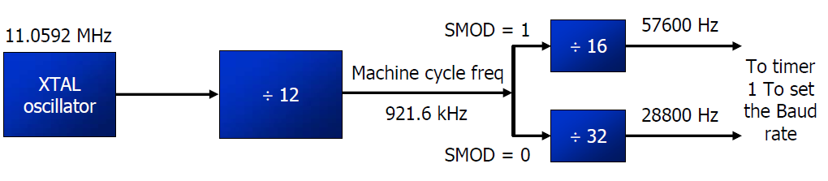
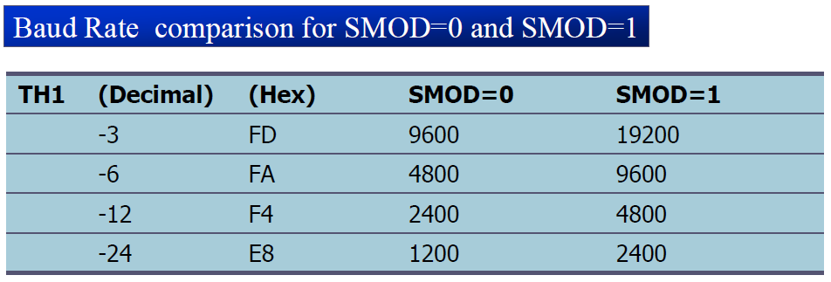
8051 Serial Communication
Doubling Baud Rate

Slide 71
8051 Connection to RS232
RS232 standards
To allow compatibility among data communication equipment made by various manufacturers, an interfacing standard called RS232 was set by the Electronics Industries Association (EIA) in 1960.
In 1963 it was modified and called RS232A. RS232B and RS232C were issued in 1965 and 1969, respectively.
RS232 is the most widely used serial I/O interfacing standard.
In RS232, a ‘1’ is represented by -3 to -25 V, while a ‘0’ bit is +3 to +25 V, making -3 to +3 undefined.
For this reason, to connect any RS232 to a microcontroller system we must use voltage converters (MAX232 ) to convert the TTL logic levels to the RS232 voltage levels, and vice versa.

Slide 72
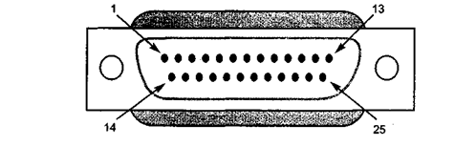
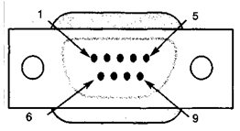
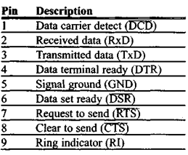
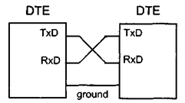
8051 Connection to RS232
RS232 pins
RS232 cable, commonly referred to as the DB-25 connector
Since not all the pins are used in PC cables, IBM introduced the DB-9 version of the serial I/O standard, which uses 9 pins only

Slide 73
8051 Connection to RS232
8051 connection to RS232
The RS232 standard is not TTL compatible; therefore, it requires a line driver such as the MAX232 chip to convert RS232 voltage levels to TTL levels, and vice versa.
RxD and TxD pins in the 8051
Pin 11 of the 8051 (P3.1) is assigned to TxD and pin 10 (P3.0) is designated as RxD (P3.0 and P3.1).
These pins are TTL compatible; therefore, they require a line driver (MAX232 chip) to make them RS232 compatible.

Slide 74
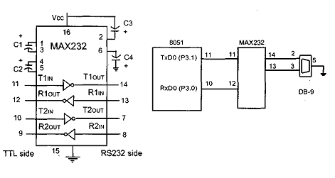
8051 Connection to RS232
8051 connection to RS232

